Slide 1
Detecting Anomalous objects in GitHub Repositories: Anomaly Detection in Source Code
-Ragnarök

Slide 2

Contents
Introduction
Problem Statement
Statistical Approach
Implementation
Results
Conclusion

Slide 3
Introduction
Anomaly detection in source code is the process of identifying unusual or unexpected patterns or behaviors within a software codebase. Anomalies in source code can take many forms, including security vulnerabilities, programming errors, code smells, and unusual usage patterns. Anomaly detection is important for ensuring the quality and security of software systems, as it can help identify potential issues before they become critical problems.
To detect anomalies in source code, various techniques and tools are used, such as static analysis, dynamic analysis, machine learning, and data mining. These approaches can help identify patterns and deviations from normal behavior, which can then be used to flag potential threats and vulnerabilities.

Slide 4
Problem Statement
The problem of anomalous object detection in source code is an important one, as it can help identify potential security vulnerabilities, programming errors, and other issues that can impact the quality and reliability of software systems.
The complexity and size of modern software systems make it challenging to identify anomalies manually, and automated approaches are needed to assist developers and security professionals in detecting potential issues.

Slide 5
Statistical Approach
To solve the problem of Anomalous objects detection in GitHub Repositories, we have curated a dataset which consists of about 45 repositories ranging from one contributor to 70 contributors to test the proposed statistical model.
All the sample parameters are then used to estimate the population parameters. The population must be approximately normal according to the central limit theorem (CLT). This distribution is then modelled and used along with the Empirical Rule of statistics to detect the anomalous source/documentation files.

Slide 6

The Real-Time model we have created Can work on any GitHub repository to find out the level of Anomalous behavior and any discrepancy in the code.
The Z-score is used as a parameter found out by the formula

Slide 7
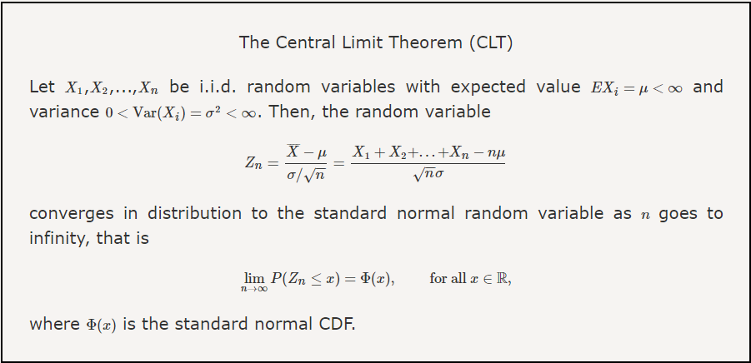

Slide 8
Implementation
The tool considers only the UTF-8 encoded files (usually source codes and documentations) in the repository. Statistics are calculated of each such file using the UTF-8 or ASCII values of each character in the file. The statistics that we are interested in are the mean and standard deviation of those files. These form multiple samples of the repository (i.e., the population).

Slide 9
Results
Let us now look into the model to understand how the anomalous detector works with the realtime model.

